Slide 1

Linear Regression in Machine Learning
Understanding the foundational algorithm that powers predictive analytics and data-driven decision making across industries.

Slide 2

What is Linear Regression?
Linear regression is a fundamental machine learning technique used to predict a continuous dependent variable based on one or more independent variables. It establishes a mathematical relationship by fitting a straight line through the data points.
Common Applications
Predicting house prices based on size, number of bedrooms, and location
Forecasting sales revenue from advertising spend
Estimating student exam scores from study hours
The basic equation is elegantly simple: Y = B₀ + B₁X, where Y is the predicted value, B₀ is the intercept, and B₁ is the slope coefficient.
Calculating insurance premiums from risk factors

Slide 3

Types of Linear Regression
Simple Linear Regression
Multiple Linear Regression
Uses one independent variable to predict the dependent variable. Perfect for understanding direct relationships.
Employs two or more independent variables for more accurate predictions by capturing complex relationships.
Example: Predicting weight from height
Example: Predicting salary from experience, education, and location
The equation expands to: Y = B₀ + B₁X₁ + B₂X₂ + ... + BnXn, where each coefficient represents the impact of its corresponding variable on the prediction.

Slide 4
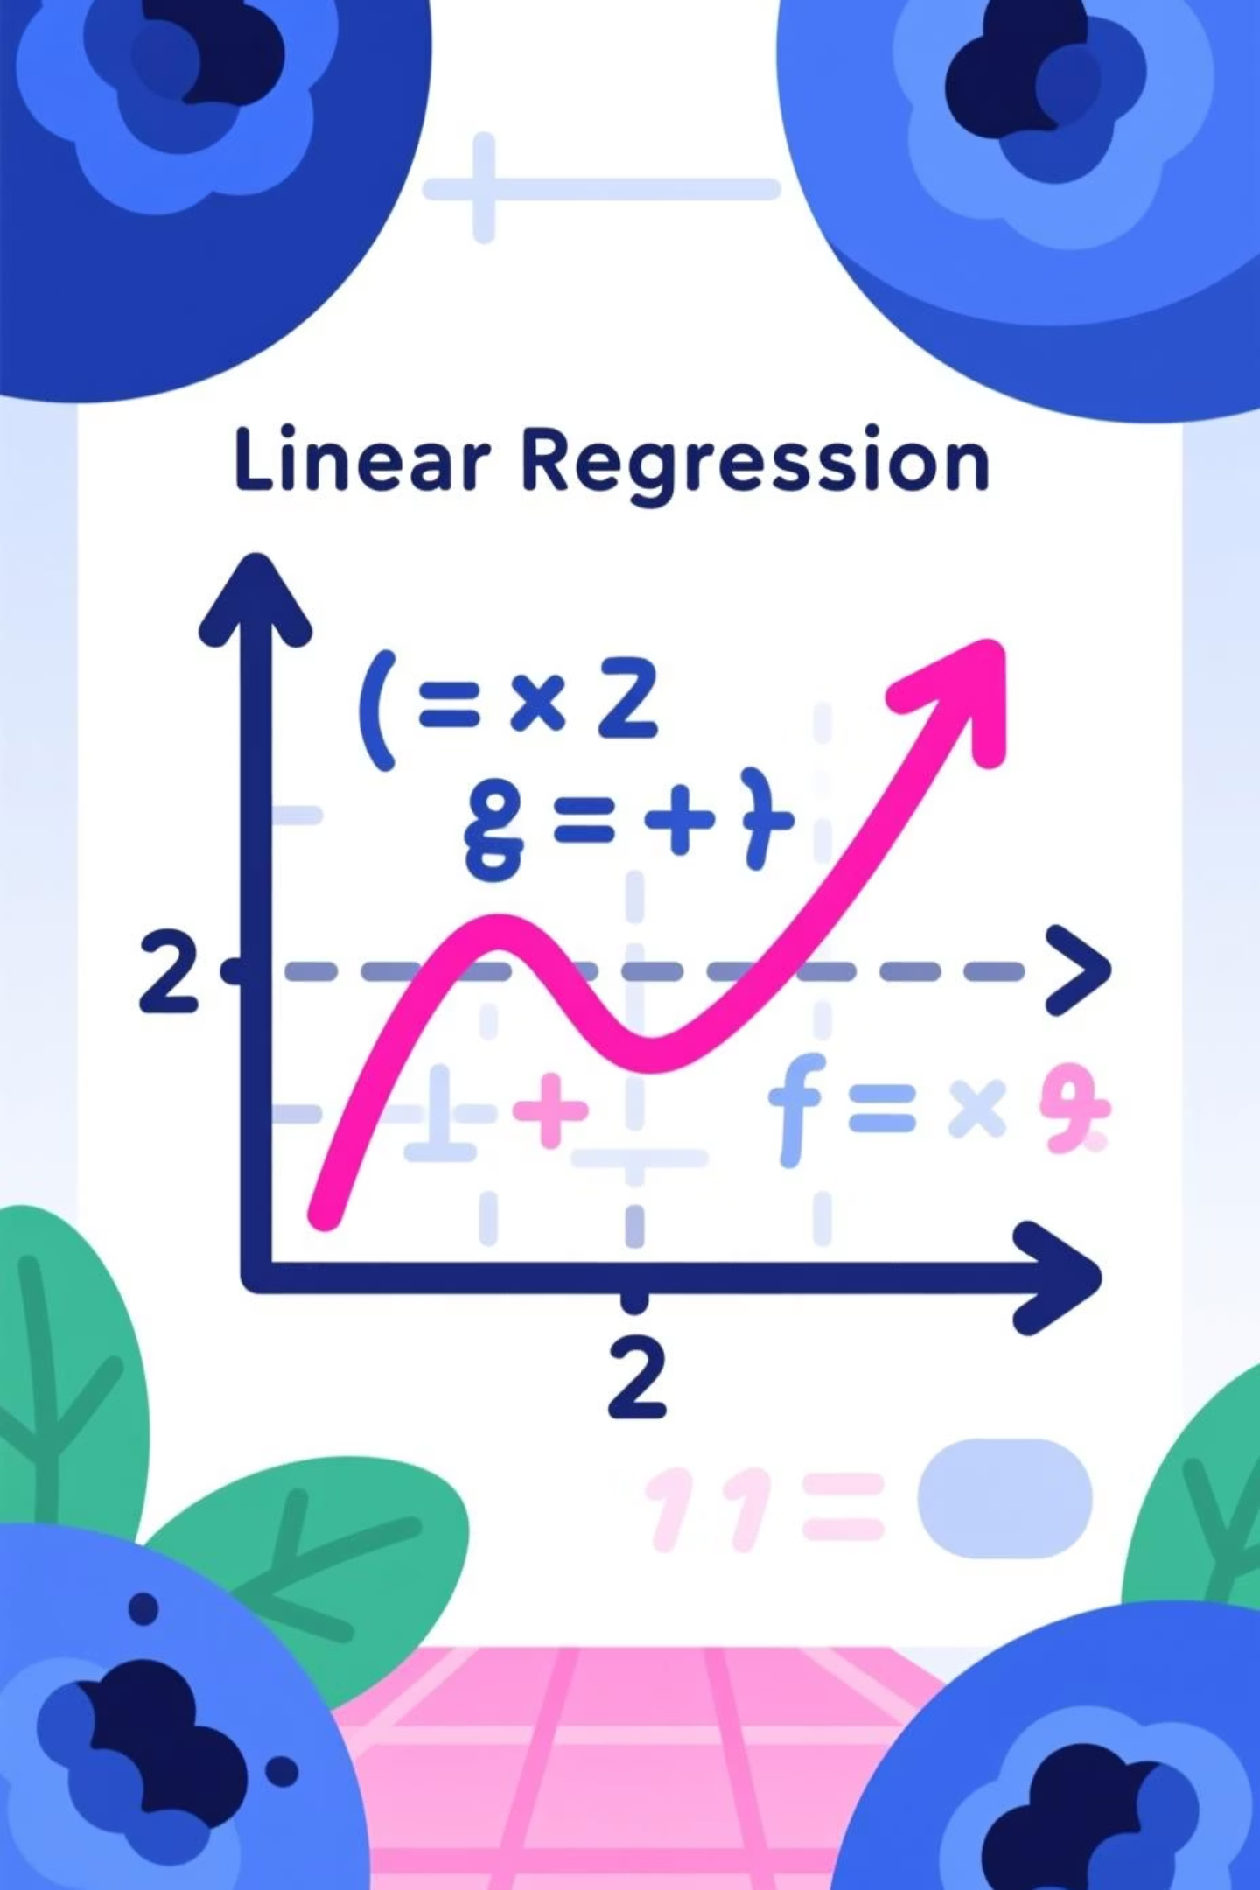
The Mathematics Behind Linear Regression
01
02
Define the Objective
Calculate Coefficients
Find the best-fit line that minimises the sum of squared differences between actual and predicted values (Residual Sum of Squares).
B₀ (intercept) represents the baseline value, whilst B₁, B₂, etc. (slopes) show how much each variable influences the outcome.
03
Optimise the Line
Use gradient descent or normal equation methods to iteratively adjust coefficients until the error is minimised.
The visual representation shows a scatter plot with data points and the regression line cutting through them, minimising the vertical distances from points to the line.

Slide 5
Key Assumptions & Evaluation Metrics
Critical Assumptions
Model Evaluation
Linearity
R²
RMSE
A linear relationship must exist between independent and dependent variables.
Coefficient of Determination
Root Mean Squared Error
Independence of Errors
Average prediction error magnitude in the same units as the target variable.
Measures how well the model fits the data (0 to 1, higher is better).
Residuals (errors) should be independent of each other with no autocorrelation.
Homoscedasticity
Constant variance of errors across all levels of independent variables.
No Multicollinearity
Independent variables should not be highly correlated with each other in multiple regression.

Slide 6





Implementing Linear Regression in Python
Import Essential Libraries
Load NumPy for numerical operations and scikit-learn's LinearRegression class for model building.
Prepare Your Data
Organise features into matrix X (independent variables) and target into vector Y (dependent variable). Split into training and testing sets.
Create & Train the Model
Instantiate the LinearRegression object and train it using the .fit(X, Y) method on your training data.
Make Predictions
Use .predict(new_X) to generate predictions on new or test data and evaluate model performance.
from sklearn.linear_model import LinearRegressionimport numpy as np# Create and train modelmodel = LinearRegression()model.fit(X_train, y_train)# Make predictionspredictions = model.predict(X_test)

Slide 7

Real Example: Predicting Car Prices
Input Features
Model Insights
After training on historical car sales data, the model learns specific coefficients that quantify how each feature impacts the final price prediction.
Mileage (km)
Higher mileage typically reduces car value
For instance, the model might reveal that each additional year of age reduces the price by ₹45,000, whilst every 10,000 km of mileage decreases value by ₹12,000.
Age (years)
Older vehicles depreciate in price
These insights help both buyers and sellers make informed decisions in the automotive market.
Engine Size (cc)
Larger engines often command premium prices

Slide 8
Challenges & Advanced Techniques
Overfitting & Underfitting
Multicollinearity Issues
Regularisation Methods
Beyond Linear Models
When independent variables are highly correlated, coefficient estimates become unstable and unreliable. Use VIF scores or correlation matrices to detect and address this.
Ridge (L2) and Lasso (L1) regression add penalty terms to prevent overfitting and improve model generalisation on unseen data.
When relationships are non-linear, consider polynomial regression, decision trees, or other algorithms that capture complex patterns in the data.
Balance model complexity to avoid memorising training data (overfitting) or being too simplistic (underfitting). Use cross-validation for optimal performance.

Slide 9


Real-World Applications in India
Stock Price Forecasting
Financial analysts use linear regression to predict stock prices based on historical trends, trading volumes, and market indicators on NSE and BSE.
Medical Insurance Pricing
Insurance companies calculate premiums by analysing age, medical history, lifestyle factors, and geographical location to assess risk accurately.
Retail Demand Forecasting
E-commerce platforms and retailers predict product demand during festivals, seasons, and sales events to optimise inventory management.
Environmental Analysis
Researchers model pollution levels and temperature trends in cities like Delhi and Mumbai to inform policy decisions and public health measures.

Slide 10





Why Master Linear Regression?
Foundation for Advanced ML
Understanding linear regression provides the conceptual groundwork for neural networks, ensemble methods, and deep learning architectures.
Interpretability Matters
Unlike black-box models, linear regression offers clear insights into how each variable influences predictions, crucial for business decisions.
Quick Implementation
With just a few lines of code, you can build, train, and deploy a working model, making it ideal for rapid prototyping and analysis.
Data-Driven Decisions
Transform raw data into actionable predictions that drive strategy, optimise operations, and create competitive advantages across industries.
"Start with linear regression to understand the fundamentals, then explore more complex models as your data and problems demand greater sophistication."

